Slide 1
Radial Basis Function(RBF) Networks

Slide 2
What does RBF Network do?
It performs a non-linear transformation over the input vectors before the input vectors are fed for classification.
So, using such a non-linear classification it is possible to converge a linearly non separable problem to a linearly separable problem.

Slide 3
Consists of Three Layers:
The input layer is made up of source nodes(sensory units) that connect the network to its environment,
The second layer, consisting of hidden units, applies a non linear transformation from the input space to the hidden(feature)space.
The output layer is linear, designed to supply the response of the network to the activation pattern applied to the input layer.

Slide 4
The non linear transformation from the input space to the hidden space and the high dimensionality of the hidden space satisfy the only two conditions of Cover’s theorem.
Much of the theory developed on RBF networks builds on the Gaussian function, an important member of the class of radial-basis functions.

Slide 5
COVER’S THEOREM ON THE SEPARABILITY OF PATTERNS
“A complex pattern-classification problem, cast in a high-dimensional space nonlinearly, is more likely to be linearly separable than in a low-dimensional space, provided that the space is not densely populated.”
When a radial-basis function (RBF) network is used to perform a complex pattern classification task, the problem is basically solved by first transforming it into a high dimensional space in a nonlinear manner and then separating the classes in the output layer.

Slide 6
Cover’s theorem on the separability of patterns encompasses two basic ingredients:
1. nonlinear formulation of the hidden function defined by _{i}(x), where x is the input vector and i = 1, 2, ...,m1;
2. high dimensionality of the hidden (feature) space compared with the input space, where the dimensionality of the hidden space is determined by the value assigned to m1 (i.e., the number of hidden units).

Slide 7
However, in some cases the use of nonlinear mapping (i.e., point 1) may be sufficient to produce linear separability without having to increase the dimensionality of the hidden-unit space.
Eg. XOR problem

Slide 8
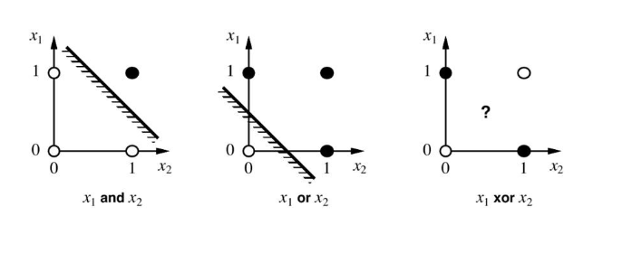

Slide 9
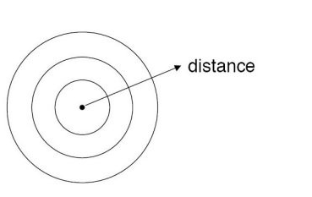
What is a radial basis function?
we define a receptor = t
we draw confrontal maps around the receptor.
Gaussian Functions are generally used for Radian Basis Function(confrontal mapping). So we define the radial distance r = ||x- t||.

Slide 10
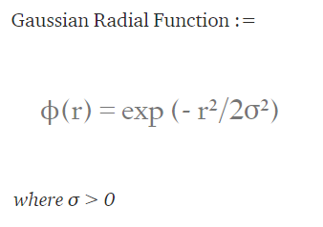

Slide 11
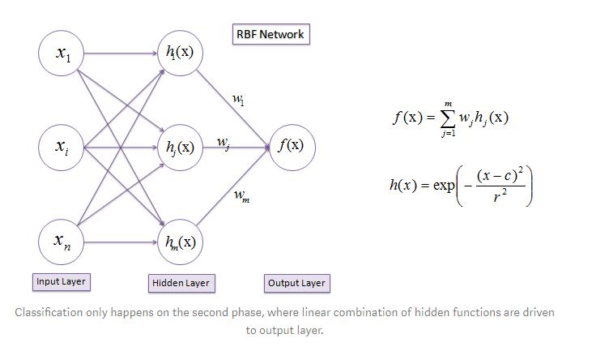

Slide 12
RADIAL-BASIS-FUNCTION NETWORKS
1. Input layer, which consists of m_{o} source nodes, where m_{o} is the dimensionality of the input vector x.
2. Hidden layer, which consists of the same number of computation units as the size of the training sample, namely, N; each unit is mathematically described by a radial basis function
_{j}(x) =  (||x - x_{j} || ), j = 1, 2, ... , N
The jth input data point xj defines the center of the radial-basis function, and the vector x is the signal (pattern) applied to the input layer.
Thus, unlike a multilayer perceptron, the links connecting the source nodes to the hidden units are direct connections with no weights.

Slide 13
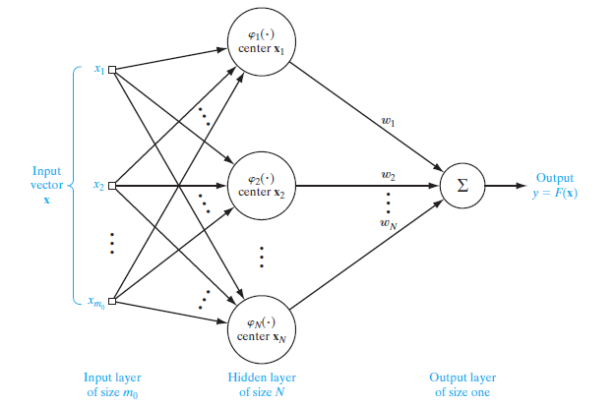
Output layer, which, in the RBF structure of Fig. 5.3, consists of a single computational unit. Clearly, there is no restriction on the size of the output layer, except to say that typically the size of the output layer is much smaller than that of the hidden layer.

Slide 14
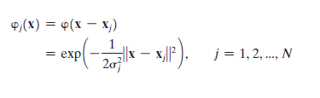
Gaussian function as the radial-basis function defined by
where j is a measure of the width of the jth Gaussian function with center xj. Typically, but not always, all the Gaussian hidden units are assigned a common width .
In situations of this kind, the parameter that distinguishes one hidden unit from another is the center xj.

Slide 15
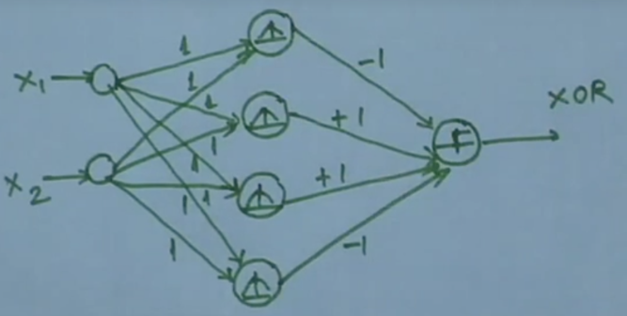

Slide 16
RBFNN Vs MLP
Has a single hidden layer.
Computational nodes in hidden layer are different and serve a different role from those in output layer.
Hidden layer is non linear whereas output layer is linear.
Activation function of each hidden unit computes the Euclidean distance between the input vector and centre of that unit.
Has one or more hidden layers.
Usually computational nodes in hidden and output layer share a common neuron model.
Hidden and output layer are usually non linear.
Activation function of each hidden unit computes the inner product of the input vector and the synaptic weight of that unit.

Slide 17
A kernel takes your input features, transforms them into some other space and then essentially works with those transformed features (when you apply the kernel trick, you do all this implicitly, but that doesn't change this fact), and then does a linear classification in that new space.

